Slide 1
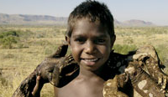
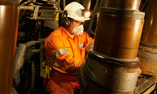

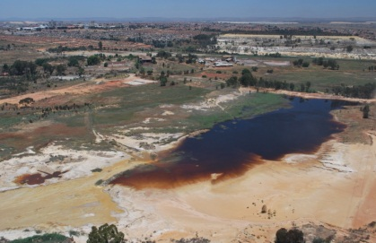
Mining’s contribution to sustainable development
Trends and Conflicts in the Extractives Sector: Designing Public Policy for a More Sustainable Future
Rio+20
Tuesday 1 June 2012.
Ben Peachey,
Director, International Council on Mining and Metals

Slide 2


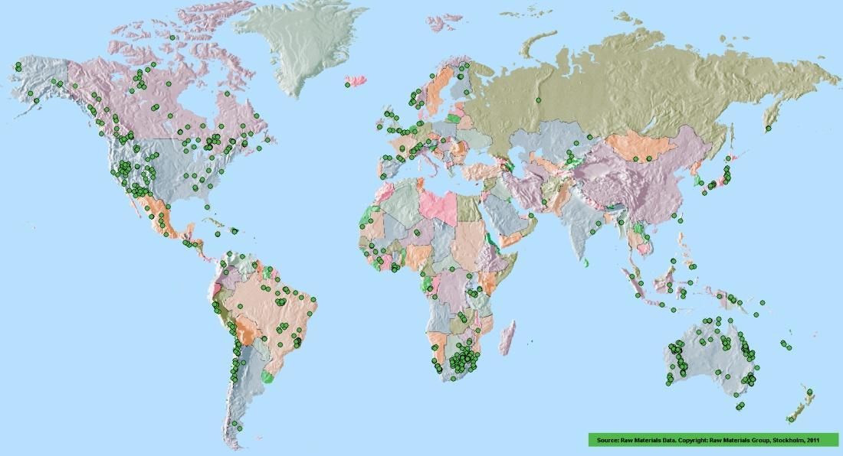
ICMM at a glance
CEO led
22 Company members
34 Association members
Over 800 sites in 62 countries

Slide 3
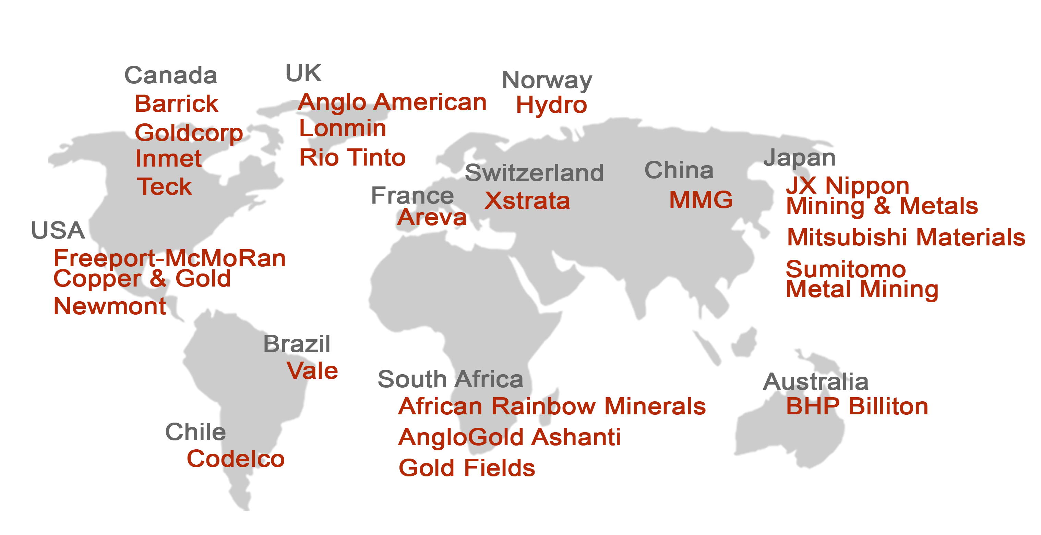
ICMM member companies
Notes:
Our members are 22 of the leading mining companies in the world.

Slide 4

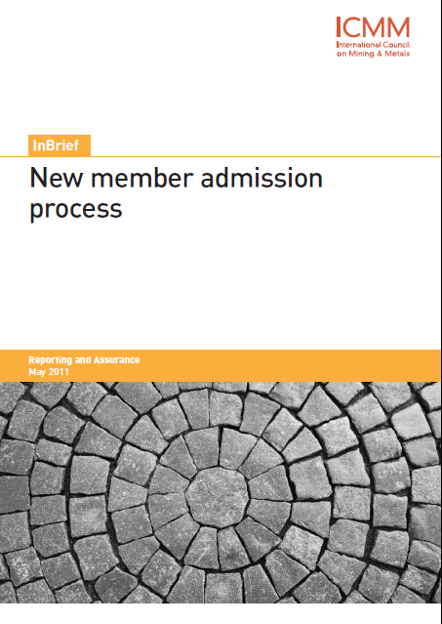
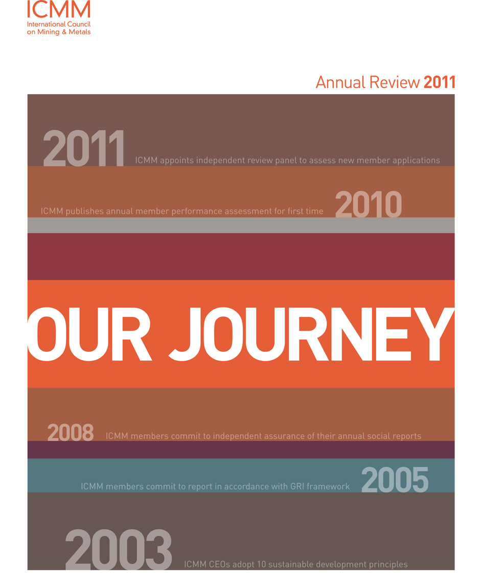
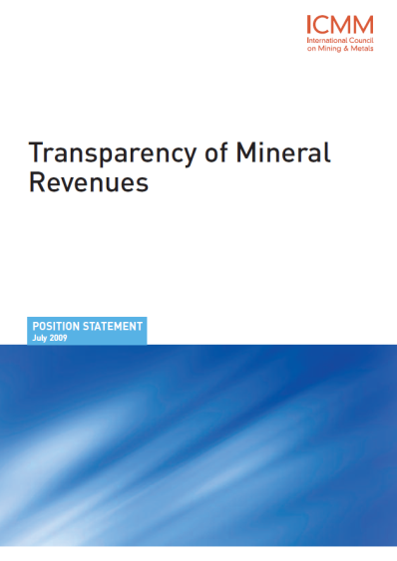
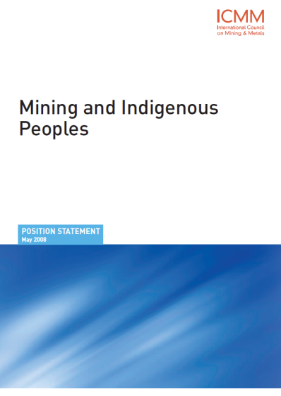
Enhanced transparency and accountability
Robust entry criteria and process
Clear performance expectations
Reporting

Slide 5
The value proposition of enhanced transparency and accountability
Better decision-making
Transparency and accountability
Enhanced Trust
Notes:
CSR reporting is not enough
Improved performance is the goal

Slide 6
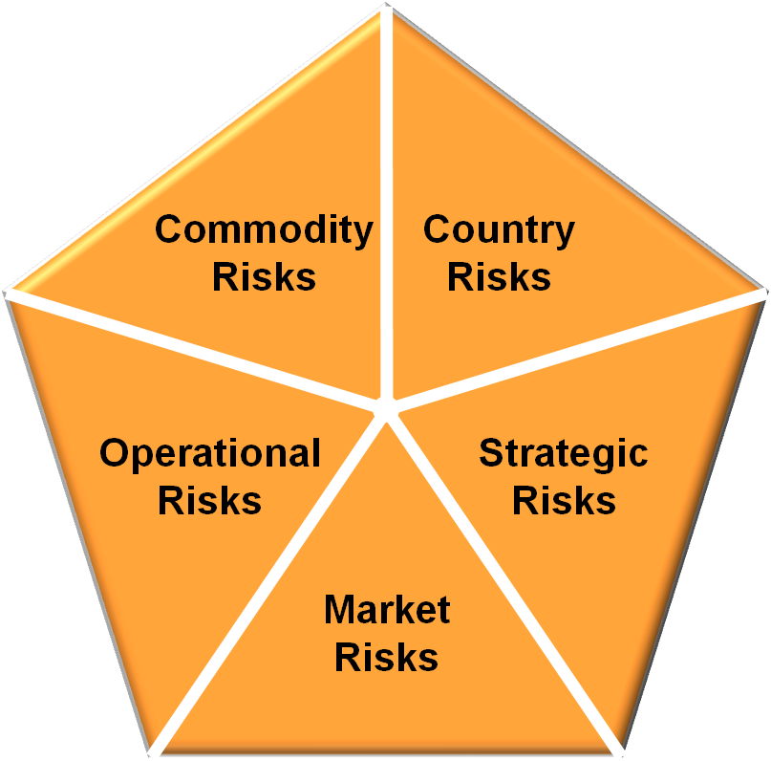
Mining sector risks... and opportunities
Life cycle aspects, e.g. recyclability, disposal
Chemicals management/ inherent HSE risks
Supply/value chain
Market access
Political instability
War/civil disturbance
Expropriation
Breach of contract
Resource access – land, energy, water
Access to capital & talent
Climate change
Reputation
Business interruption
H&S and ESG
Failure of systems
Regulatory non-compliance
Commodity price
Interest rate risks
Currency Risks
Equity risks

Slide 7
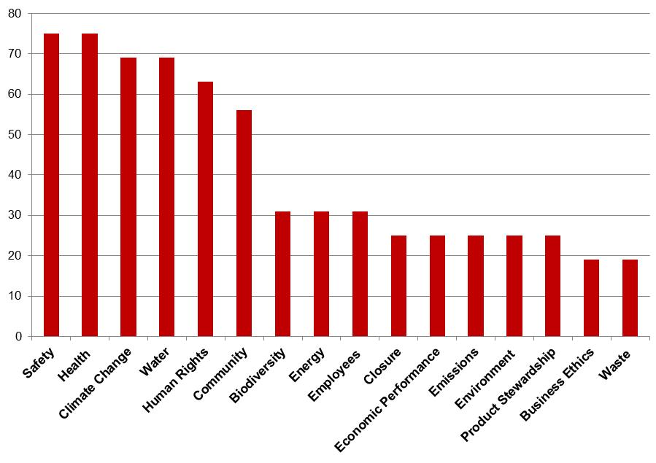
Material issues – 2011 SD reports
% of reports identifying issues as material

Slide 8
Reality check: key trends
Increasing public concerns (climate change, water, human rights, biodiversity, corruption and transparency, workplace fatalities, distribution of economic benefits of mining, poverty reduction, indigenous peoples’ role in decision-making)
Increased emphasis on corporate social and environmental practices
Increased NGO campaigning on a range of issues (community consent, ethical sourcing, biodiversity, energy minerals, chemicals management)
Increasing complexity and breadth of issues facing the industry
Growing recognition that no single interest can address issues effectively (growing need for multi-interest collaboration)
Intensifying political struggles over distribution of resource rents
1
2
3
4
5
6
Notes:
Increasing public concern about: 1) climate change; (2) water; (3) human rights; (4) biodiversity; (5) corruption and transparency; (6) workplace fatalities; (7) economic benefits of mining and poverty reduction; (8) indigenous peoples’ role in decision-making

Slide 9
Operating environment – key trends
Strong demand continuing – with some bumps and supply challenges
Poor or middle income countries dominate the top 30 national mining and metals economies – increasing dependency
From global production perspective, higher and high middle-income countries dominate
Schedule/cost over-runs remain significant – community and civil society resistance a key factor in commissioning delays
  73% of project delayed
  Conflict on the increase
  What is fair?
Source: OPM and ICMM
Notes:
Increasing dependency on mining and metals for many low- and middle-income countries
There remains a gap between the potential and realized contribution of mining and metals to national economies.
Action is needed at the local level to overcome this gap – this is where the greatest criticisms are apparent and where the need to develop trusting relationships is greatest

Slide 10
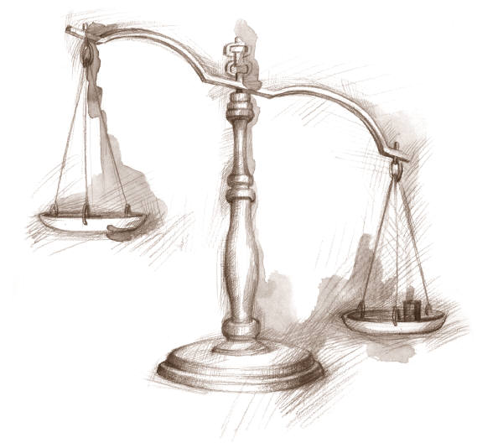
Understand the contribution
Costs + Risks
Benefits
Responsibilities
6

Slide 11
Understanding the benefits (1)

Slide 12


Understanding the benefits (2)
Economic
Social
Cultural
Towards integrity, trust and
strengthened reputation
Environ-
mental
Restoration ecology
7

Slide 13
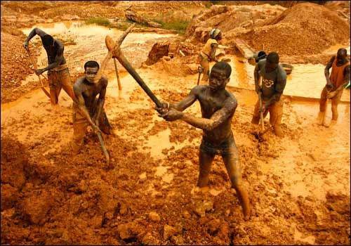

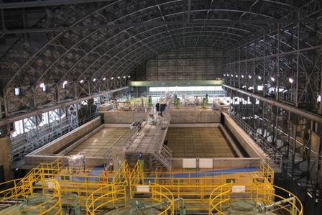
From the dark side to a positive agent of social change
10

Slide 14
For further information:
www.icmm.com
@icmm_com
Notes:
14

